Slide 1
SRI RAMAKRISHNA ENGINEERING COLLEGE
[Educational Service : SNR Sons Charitable Trust]
[Autonomous Institution, Reaccredited by NAAC with ‘A+’ Grade]
[Approved by AICTE and Permanently Affiliated to Anna University, Chennai]
[ISO 9001-2015 Certified and all eligible programmes Accredited by NBA]
VATTAMALAIPALAYAM, N.G.G.O. COLONY POST, COIMBATORE – 641 022.
Department of Electronics and Communication Engineering
20EC214 & DIGITAL CMOS VLSI CIRCUITS
Course Instructor:
Mr.R.Chandru,
Assistant Professor(Sl.G)/ECE
No. of Credits : 3

Slide 2
20EC214 - DIGITAL CMOS VLSI CIRCUITS COURSE OUTCOMES
On successful completion of the course, students will be able to,
COURSE OUTCOMES
CO₁ | Interpret the characteristics and manufacturing process technologyof MOS transistor.
CO₂ | Analyze the various logic styles of CMOS combinational andsequential circuits
CO₃ | Design the various digital arithmetic logic circuits.
CO₄ | Illustrate the performance of the digital circuits by examining the timing issues.
CO₅ | Make use of MOS concepts in construction of Memory Array Subsystem.

Slide 3
20EC214 - DIGITAL CMOS VLSI CIRCUITS COURSE CONTENTS
PREREQUISITES
20EC204 - Digital System Design
MOS TRANSISTOR AND PROCESSING 10
MOSFET theory - Transistor switches - Compound gates - Design equations - IV characteristics - CV characteristics - Second order effects - Energy and Power - Resistance Estimation - Capacitance Estimation - Switching Characteristics - RC Delay Models - Logical Effort for gates - CMOS Process technology - Design Rules and Layout.
CMOS LOGIC STRUCTURES 11
Combinational Circuits: CMOS Inverter - DC Characteristics - Complementary Logic Structures - Ratioed logic - Pass transistor logic - Transmission gate - Tristate Inverter - Multiplexers - Dynamic logic structures. Sequential Circuits: Static latches and Registers, Dynamic latches and Registers, Pulse Registers, Sense Amplifier Based Register, Pipelining.
DESIGN OF ARITHMETIC BUILDING BLOCKS 8
Full adder, Ripple carry adder, Carry bypass adder, Linear and Square root carry-select adder, Carry look-ahead adder - Multipliers - Barrel and logarithmic shifter.
TIMING ISSUES 8
Timing Basics, Sources of Skew and Jitter, Clock-Distribution Techniques, Latch-Based locking, Self-Timed Circuit Design, Synchronizers and Arbiters, Clock Synthesis and Synchronization Using a Phase-Locked Loop.
MEMORY ARRAY SUBSYSTEM 8
SRAM: SRAM Cells, Row Circuitry, Column Circuitry. Multiported SRAM and Register files DRAM: Subarray Architectures, Column Circuitry, Embedded DRAM. Read-Only Memory: Programmable ROMs, NAND ROMs, Flash.

Slide 4
20EC214 - DIGITAL CMOS VLSI CIRCUITS COURSE CONTENTS
TEXT BOOKS
Neil H.E. Weste and David Harris, "CMOS VLSI Design A Circuits and Systems Perspective", 4th Edition, Pearson Education, Reprint 2010.
Jan M. Rabaey, Anantha Chandrakasan and B Nikolic, "Digital Integrated Circuits: A Design Perspective", 2nd Edition, Pearson Education India, 2016.
REFERENCES
Douglas. A. Pucknell, Kamran Eshraghian, "Basic VLSI Design", 3rd Edition, Prentice Hall India, 2010.
John P.Uyemura, "Introduction to VLSI Circuits and Systems", John Wiley & Sons, 2012.
WEB REFERENCES
https://nptel.ac.in/courses/108/107/108107129/
https://nptel.ac.in/courses/117/106/117106093/

Slide 5
MODULE 5 MEMORY ARRAY SUBSYSTEM
□ Introduction to Memory Systems
□ SRAM – Static Random Access Memory
□ SRAM Cell Design
□ SRAM Read and Write Operations
□ Row Decoder and Word Line Design
□ Column Circuitry and Bit Line
□ Multiported SRAM
□ Register Files
□ DRAM – Dynamic Random Access Memory
□ DRAM Cell Operation
□ DRAM Subarray Architecture
□ Column Circuit in DRAM
□ Embedded DRAM
□ Read Only Memory (ROM)
Programmable ROM
NAND ROM
Flash Memory

Slide 6
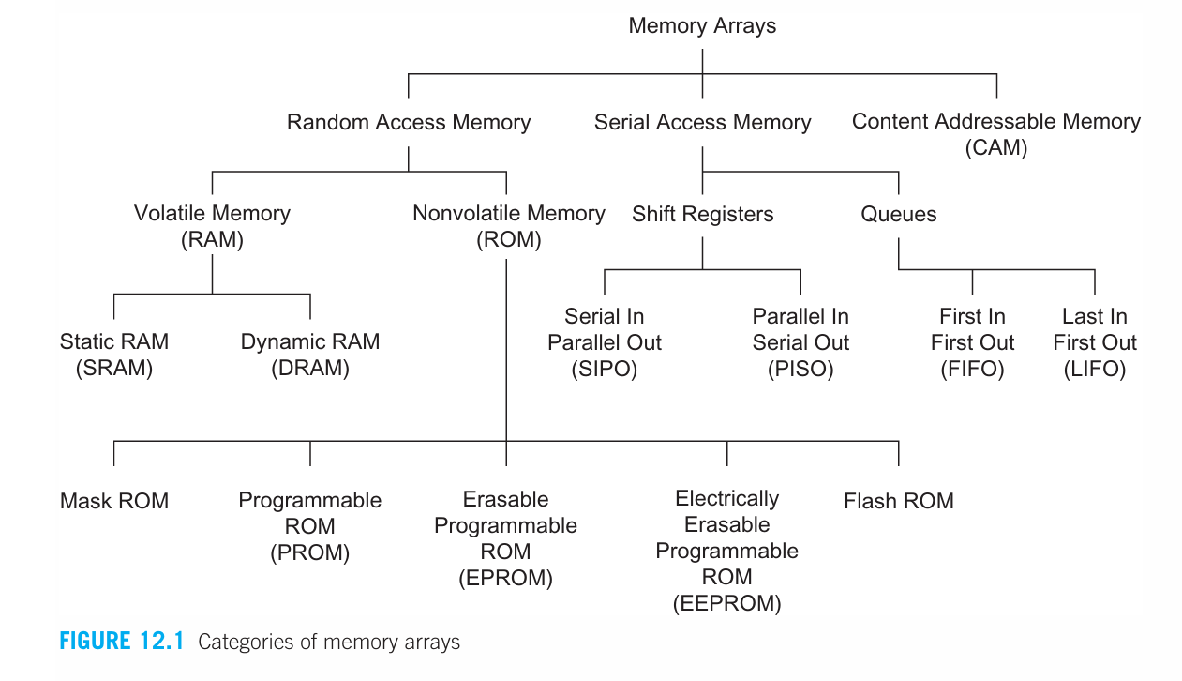
MODULE 5
Memory Array Subsystem
Memory Access
Memory Classification (Important Concept)
Old Classification (Confusing)
ROM (Read Only Memory)
RAM (Read/Write Memory)
👉 Problem:
Some ROMs can actually be written (e.g., EEPROM, Flash).

Slide 7
MODULE 5
Memory Array Subsystem
Random Access Memory (RAM)
Serial Access Memory
Content Addressable Memory (CAM)
Accessed using an address.
Access time is constant, no matter which location you choose.
Example: Accessing any index in an array directly.
👉 Key idea: Fast and direct access
Data is accessed sequentially.
No direct address access.
Example: Tape storage, shift registers.
👉 Key idea: Must go step-by-step
You don’t give an address.
Instead, you provide a data pattern (key).
Memory searches and returns matching locations.
👉 Key idea: Search-based memory
Memory types:
RAM → Address-based, fast
Serial → Sequential access
CAM → Search-based

Slide 8
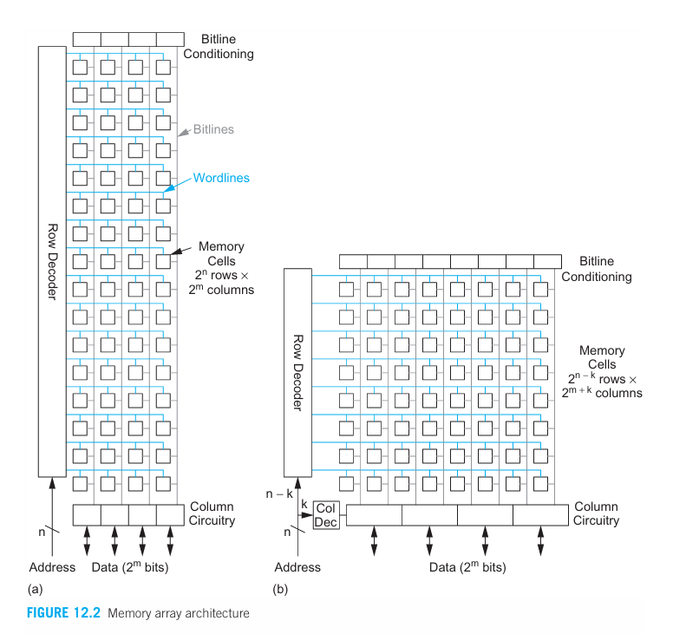
MODULE 5
Memory Array Subsystem
Basic Memory Size Representation
A memory array is defined as:
2ⁿ words
Each word has 2ᵐ bits
👉 Total memory cells = 2ⁿ × 2ᵐ
📌 Example:
n = 4 → 2⁴ = 16 words
m = 2 → 2² = 4 bits per word
👉 So memory = 16 × 4 = 64 cells
One row = one word
One column = one bit

Slide 9
MODULE 5
Memory Array Subsystem
SRAM
Static RAMs use a memory cell with internal feedback that retains its value as long as power is applied.
It has the following attractive properties:
Denser than flip-flops
Compatible with standard CMOS processes
Static RAM (SRAM) uses a memory cell with internal feedback.
It retains data as long as power is ON.
No refresh is required (unlike DRAM).

Slide 10
MODULE 5
Memory Array Subsystem
Introduction to SRAM Cells - The 6T Memory Cell
Key Concept: The fundamental building block of Static Random-Access Memory (SRAM).
Core Requirements of an SRAM Cell:
Hold Data: Retain a value (0 or 1) as long as power is supplied.
Read Data: Allow the stored value to be sensed.
Write Data: Allow the stored value to be overwritten.
The SRAM vs. Flip-Flop Trade-off:
A flip-flop can perform these functions but is physically large.
An SRAM cell achieves the same goal in a much smaller area, making it ideal for large memory arrays.

Slide 11
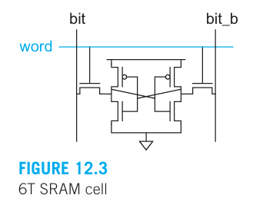
MODULE 5
Memory Array Subsystem
The Standard 6T SRAM Cell
Components of the 6T Cell:
Two Cross-Coupled Inverters: Form a "weak" latch that holds the state (0 or 1).
Two Access Transistors (Pass Gates): Connect the internal state to the bit lines for read and write operations.
Advantages of the Compact 6T Cell:
Smaller Size: An order of magnitude smaller than a flip-flop.
Lower Dynamic Power: Shorter wires result in less capacitance and lower power consumption.

Slide 12
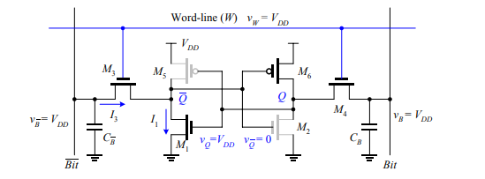
MODULE 5
Memory Array Subsystem
SRAM Read Operation (6T Cell)

Slide 13
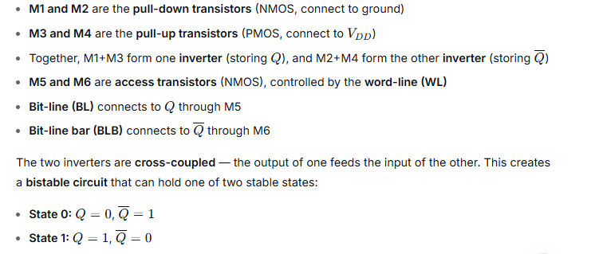
MODULE 5
Memory Array Subsystem
SRAM Read Operation (6T Cell)

Slide 14
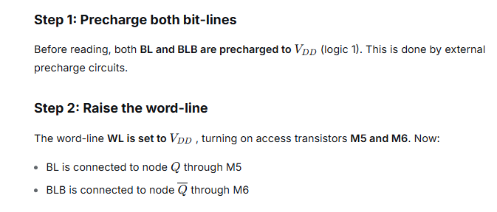
MODULE 5
Memory Array Subsystem
SRAM Read Operation (6T Cell)

Slide 15
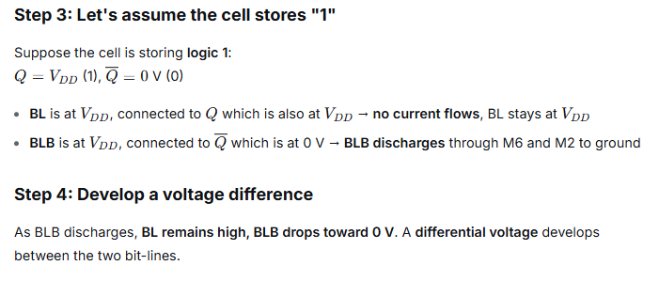
MODULE 5
Memory Array Subsystem
SRAM Read Operation (6T Cell)

Slide 16
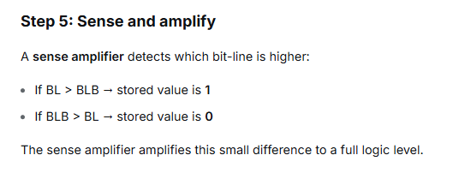
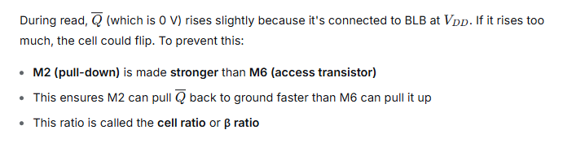
MODULE 5
Memory Array Subsystem
SRAM Read Operation (6T Cell)

Slide 17
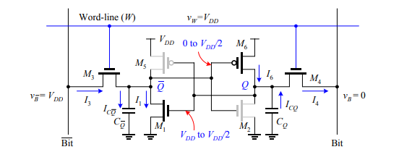
MODULE 5
Memory Array Subsystem
SRAM Write Operation (6T Cell)

Slide 18
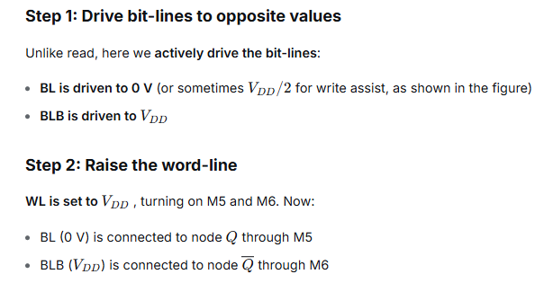
MODULE 5
Memory Array Subsystem
SRAM Write Operation (6T Cell)

Slide 19
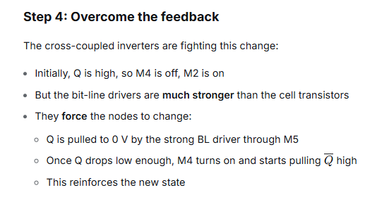
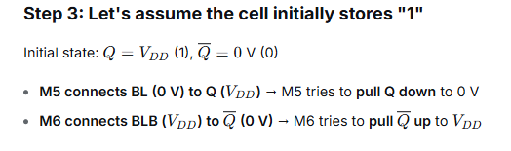
MODULE 5
Memory Array Subsystem
SRAM Write Operation (6T Cell)

Slide 20
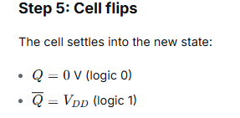
MODULE 5
Memory Array Subsystem
SRAM Write Operation (6T Cell)
In a read, the bit-lines only sense the stored value without forcing it—the cell must remain stable. In a write, the bit-lines forcibly overwrite the stored value—the cell must flip reliably. These opposing requirements are balanced through careful transistor sizing and bit-line driver strength

Slide 21
MODULE 5
Memory Array Subsystem
Read Disturb
Voltage Difference Creation
During read:
bit was HIGH initially
Q = 0 node is connected to HIGH bitline
👉 So:
Q slightly rises
If Q rises too much: Cell may flip incorrectly
Now:
bit ↓ (slightly drops)
bit_b stays HIGH
👉 This small voltage difference:
Represents stored data
If the access transistor (A1) is too strong, it will overpower the driver transistor (D1), causing Q to rise above the switching threshold of the inverter formed by P2/D2. This would cause the cell to flip its state (from 0 to 1) unintentionally, corrupting the data.
Sense Amplifier - Amplifies small difference → full logic output
To prevent the cell from flipping during a read, the transistors must be carefully ratioed.
The Rule: The Driver transistor (D1) must be stronger than the Access transistor (A1) .

Slide 22
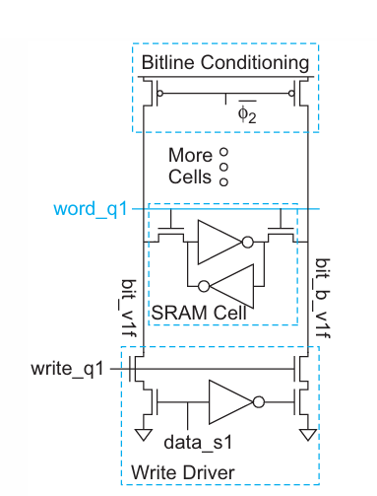
MODULE 5
Memory Array Subsystem
SRAM Write Operation
Example: Write ‘1’
bit = HIGH
bit_b = LOW
👉 Write driver:
Pulls bit_b strongly to GND
Bitlines are:
bit = HIGH
bit_b = HIGH
👉 Done by:
Bitline conditioning circuit
Assume:
Initial: Q = 0, Q̅ = 1
We want: Q = 1
The write driver forces:
One bitline → LOW
Other bitline → HIGH
Step 1: bit_b = 0 pulls Q̅ down
Through:
Write driver → bit_b
Access transistor (A2)
Signals:
write_s1 → write enable
data_s1 → data input

Slide 23
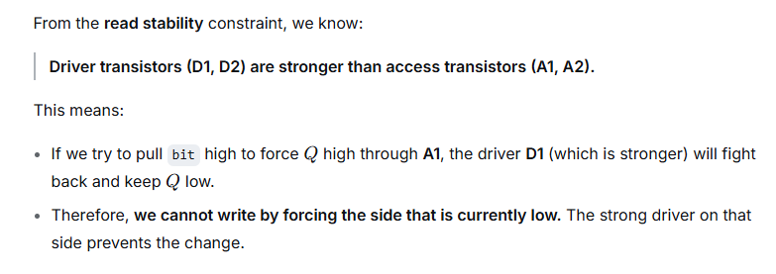
MODULE 5
Memory Array Subsystem
Why the Read Path Can't Be Used for Writing

Slide 24
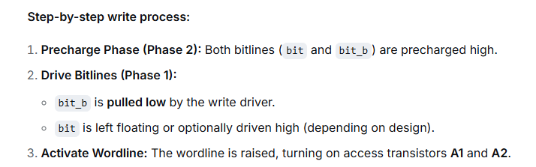
MODULE 5
Memory Array Subsystem
The Correct Write Strategy: Force the Opposite Side

Slide 25
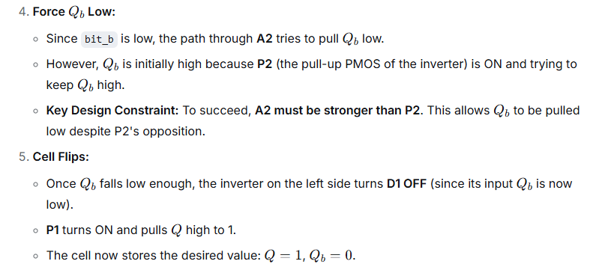
MODULE 5
Memory Array Subsystem
The Correct Write Strategy: Force the Opposite Side

Slide 26
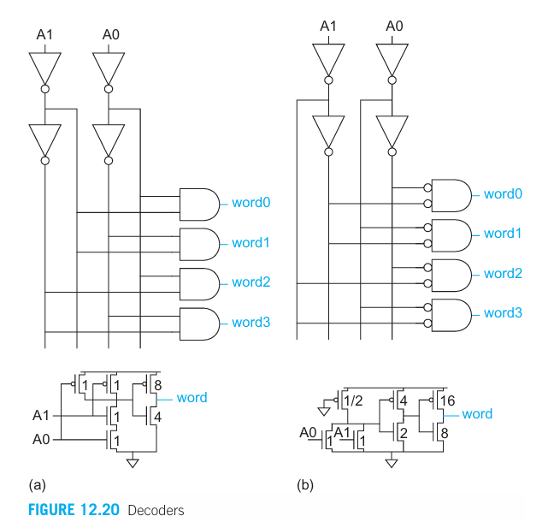
MODULE 5
Memory Array Subsystem
Introduction to Row Circuitry
The row circuitry consists of:
Decoders: Translate binary addresses into a unique wordline selection
Wordline Drivers: Buffer and drive the heavily loaded wordlines

Slide 27
MODULE 5
Memory Array Subsystem
Basic Decoder Implementations
Pseudo-nMOS NOR + Buffers
NOR gate with two inverters for buffering
Easy to build
Drawbacks:
Requires ratio constraint verification
High static power consumption
Not suitable for large arrays
Static NAND + Inverter
NAND gate followed by inverter
Useful for 5–6 inputs
NAND transistors typically minimum size to reduce load on address lines
Good for moderate speed requirements

Slide 28
MODULE 5
Memory Array Subsystem
Predecoding Fundamentals
The Problem:
Decoders have high electrical and branching effort
Many NAND gates share identical inputs
Direct implementation creates redundant circuitry
The Solution: Predecoding
Factor out common NAND gates
Blocks of pp address bits are predecoded into 1-of-2p2p-hot codes
Predecoded lines feed the final stage decoder

Slide 29
MODULE 5
Memory Array Subsystem
Dynamic Decoders
Why Dynamic Decoders?
Lower logical effort than static CMOS
Faster operation
Suitable for high-performance applications
The Power Problem with Traditional Domino:
All 256 AND gates must precharge every cycle
Only one evaluates (rises)
Clock load is extremely large
High power consumption

Slide 30
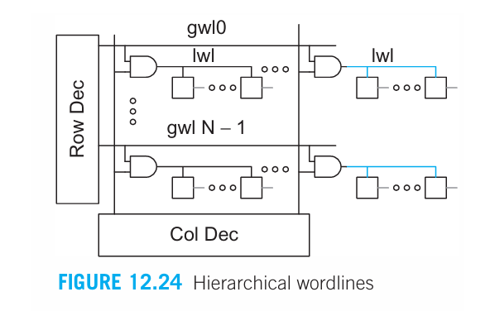
MODULE 5
Memory Array Subsystem
Hierarchical (Divided) Wordlines
The Problem with Single-Level Wordlines:
Long wordlines have high resistance (narrow lower-level metal)
High capacitance
Long RC flight time in large arrays

Slide 31
MODULE 5
Memory Array Subsystem
Hierarchical Wordlines
Global Decoding:
Address bits select a global wordline
Global wordline runs across the array
Local Decoding:
Global wordline enables local wordline drivers
Local wordlines activate only a small group of cells
Distributed Architecture:
One more level of decoding
Also called "divided wordline" architecture

Slide 32
MODULE 5
Memory Array Subsystem
Dynamic Decoders
Lower logical effort than static CMOS
Faster operation
Suitable for high-performance applications
The Power Problem with Traditional Domino:
All 256 AND gates must precharge every cycle
Only one evaluates (rises)
Clock load is extremely large
High power consumption

Slide 33
MODULE 5
Memory Array Subsystem
Introduction to Column Circuitry
The column circuitry manages data transfer between the SRAM array and the outside world.

Slide 34
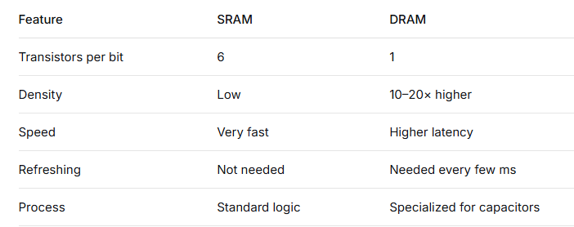
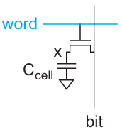
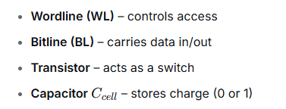

MODULE 5
Memory Array Subsystem
Dynamic RAMs (DRAMs)

Slide 35
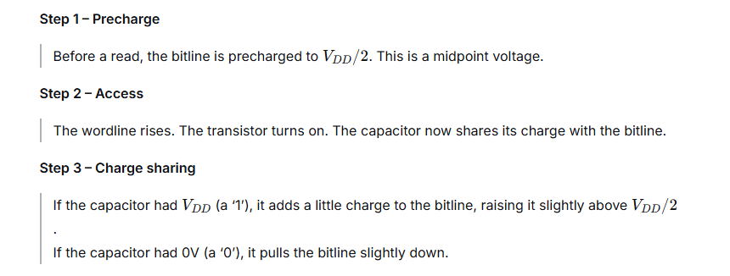
MODULE 5
Memory Array Subsystem
Read Operation

Slide 36
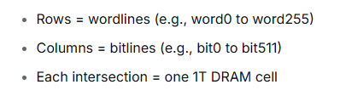
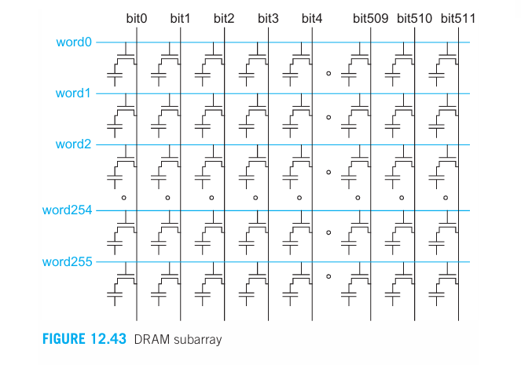
MODULE 5
Memory Array Subsystem
DRAM Subarrays & Bitline Architectures
A sense amplifier is placed at the bottom (or top) of each bitline column.

Slide 37
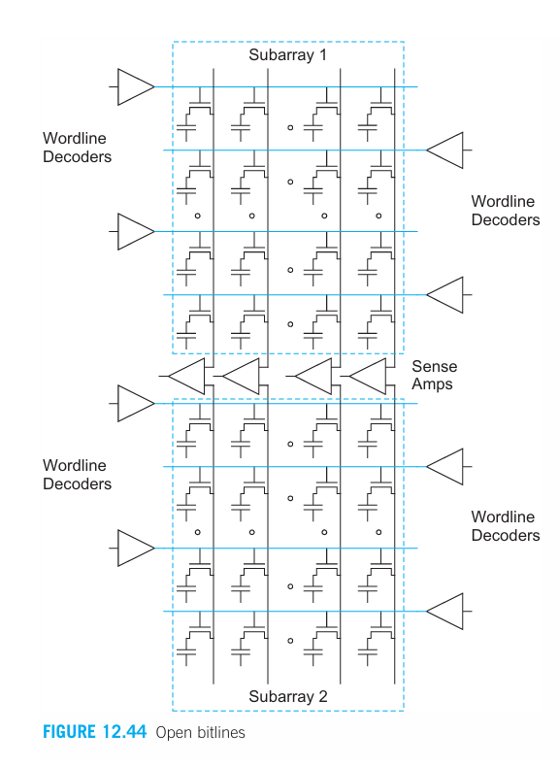
MODULE 5
Memory Array Subsystem
Open Bitline Architecture
In the open bitline architecture, each sense amplifier takes one bitline from Subarray A and one bitline from Subarray B.
Advantage:
“The arrays are very dense.” – No extra area for reference lines.
Disadvantage:
“Any noise that affects one array more than the other will appear as differential noise at the sense amplifier.”

Slide 38
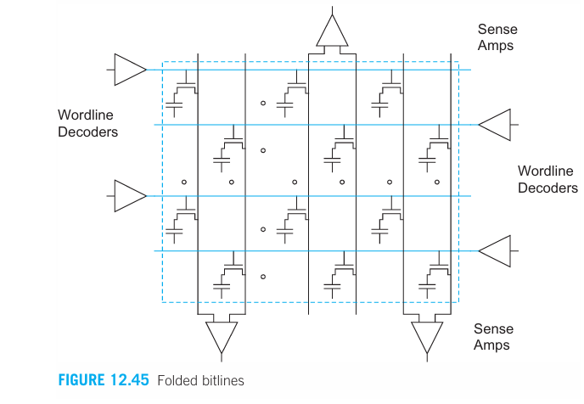
MODULE 5
Memory Array Subsystem
Folded Bitline Architecture
In the folded bitline architecture, both inputs of the sense amplifier come from the same subarray, using two adjacent bitlines: one active, one reference.
When a wordline is asserted, one bitline switches. Its immediate neighbor stays at precharge voltage and serves as the reference. The two bitlines run parallel and close together for their entire length.

Slide 39
MODULE 5
Memory Array Subsystem
Folded Bitline Architecture
Noise advantage:
“Many noise sources will couple equally onto the two adjacent bitlines so they tend to appear as common mode noise that is rejected by the sense amplifier.”
Explain common-mode rejection:
If a noise spike couples into both bitlines equally, the difference between them stays the same. The sense amplifier (differential) ignores it.
Disadvantage:
“This noise advantage comes at the expense of greater layout area.” Because each bitline connects to only half as many cells (the other half are on the reference bitline), you need more physical area.
Real-world result:
Folded bitlines are used in all modern DRAM (DDR2, DDR3, DDR4, DDR5, LPDDR).

Slide 40
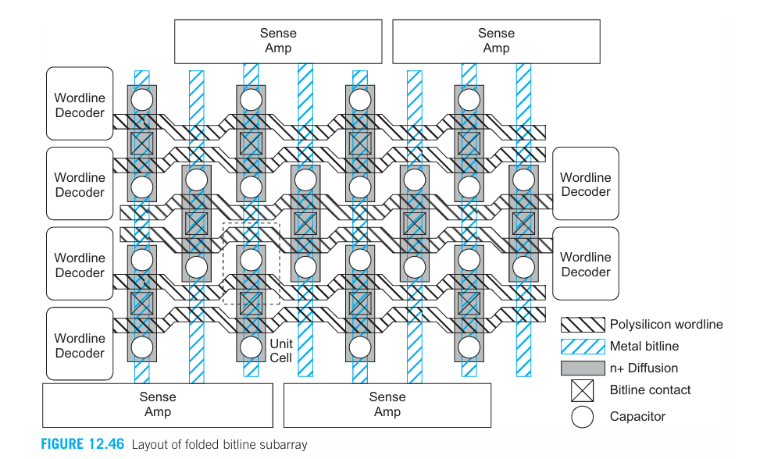
MODULE 5
Memory Array Subsystem
DRAM Column Circuitry
The job of the column circuitry – sense amplifiers, write drivers, precharge circuits, and the column multiplexer that selects which column connects to the outside world.

Slide 41
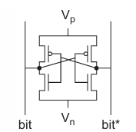
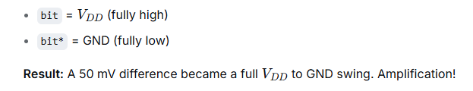
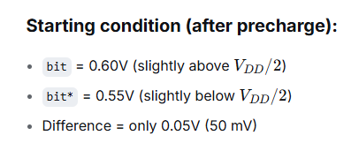
MODULE 5
Memory Array Subsystem
Sense Amplifier – Cross-Coupled Inverters
A sense amplifier is a special circuit that takes this tiny voltage difference and amplifies it to a full VDD​ (logic '1') or GND (logic '0').
It amplifies any tiny difference between bit and bit* until one is at VDD and the other at GND.
This is called positive feedback or regeneration.

Slide 42
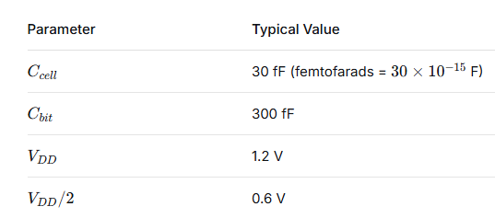
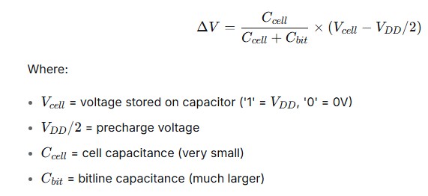
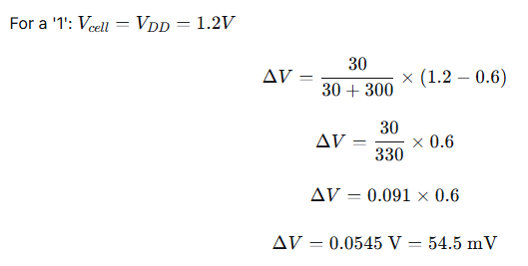
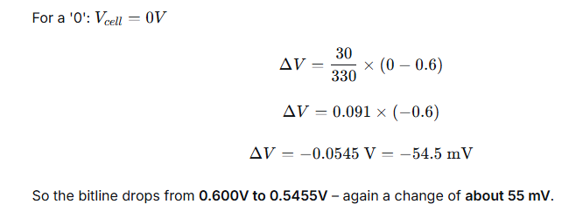
MODULE 5
Memory Array Subsystem
The voltage change on the bitline is

Slide 43
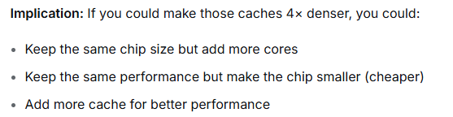
MODULE 5
Memory Array Subsystem
Embedded DRAM
"Memories now account for half or more of the area of many chips."

Slide 44
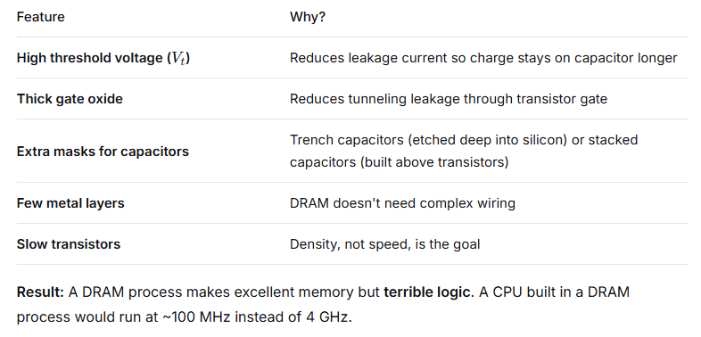
MODULE 5
Memory Array Subsystem
DRAM Process (Standalone DRAM chips like DDR5)

Slide 45
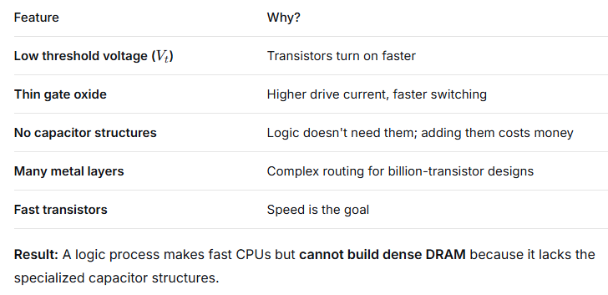
MODULE 5
Memory Array Subsystem
Logic Process (Standard CMOS for CPUs, GPUs, FPGAs)

Slide 46
MODULE 5
Memory Array Subsystem
Embedded DRAM (eDRAM)
eDRAM = Embedded DRAM. It is a logic process (so you get fast transistors) that has been modified to include dense capacitor structures.
Get DRAM density without losing logic speed
Capacitor Implementation (Critical Problem)
In standard DRAM:
Very high capacitance (deep trench / stacked)
Specialized process
In eDRAM:
You have 3 options:

Slide 47
MODULE 5
Memory Array Subsystem
1. MOS Capacitor
Definition: A MOS capacitor uses the gate oxide and substrate of a transistor to store charge.
Translation: 👉 Use the transistor itself as a capacitor.
Key Points:
Easy to integrate with logic process
No major extra fabrication steps
Capacitance is small
Problem: 👉 Small capacitor → small signal → harder to detect

Slide 48
MODULE 5
Memory Array Subsystem
🔹 2. Deep Trench Capacitor
Definition : A deep trench capacitor is formed by etching deep into the silicon substrate and filling it with dielectric and conductive material to create high capacitance.
Key Points:
Very high capacitance
Better signal (larger ΔV)
Used in advanced designs (like IBM)
Problem: 👉 Hard to manufacture (complex process)

Slide 49
MODULE 5
Memory Array Subsystem
🔹 3. MIM Capacitor (Metal-Insulator-Metal)
Definition: A MIM capacitor uses two metal plates separated by a dielectric layer to store charge.
Translation: 👉 Build a capacitor using metal layers above the transistor.
Key Points:
Higher capacitance than MOS
More stable performance
Good for analog + memory
Problem: 👉 Needs extra fabrication steps → increases cost

Slide 50
MODULE 5
Memory Array Subsystem
How eDRAM gets DRAM density without losing logic speed
🔹 1. Uses logic process
👉 Fast transistors → CPU speed maintained
🔹 5. Strong sense amplifiers
👉 Detect small signals quickly
🔹 2. Adds only few extra steps
👉 Capacitors added without slowing logic
🔹 6. On-chip placement
👉 Near CPU → low latency
🔹 3. 1T + 1C cell
👉 DRAM-style cell → high density
🔹 7. Wide internal buses
👉 High bandwidth (no pin limitation)
🔹 8. Hidden refresh
👉 No visible delay to CPU
🔹 4. Smaller arrays
👉 Short bitlines → low delay
eDRAM = Logic speed + DRAM density through minimal process changes and smart architecture

Slide 51
MODULE 5
Memory Array Subsystem
What is ROM?
Read-Only Memory (ROM) is a type of non‑volatile memory.
Non‑volatile means it retains its stored data even when power is turned off.
Read‑only means that under normal operation, you can only read data from it; you cannot easily change it.
ROM is used to store fixed information that must not be lost when the power goes away – for example, the bootstrap code (BIOS/UEFI) that a computer runs when it first starts, or fixed tables in a microcontroller.

Slide 52
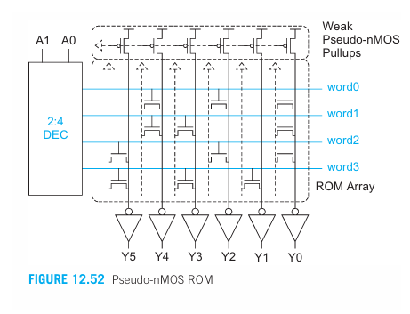
MODULE 5
Memory Array Subsystem
The NOR Array Organization
The ROM is built as a NOR array.
Wordlines run horizontally.
Bitlines run vertically.
Each bitline is connected to the drains of many transistors (one from each wordline).
All those transistors share the same bitline and all have their sources to ground.
This arrangement acts like a NOR gate on each bitline: If any of the transistors on that bitline is turned ON (because its wordline is high), the bitline will be pulled low. So the bitline voltage = NOR of the selected wordline signals (only the selected wordline matters; the others are low, so they don’t affect the bitline).
Because the bitline is low when the transistor is present, and high when no transistor is present, the bitline voltage is the inverse of the stored data.

Slide 53
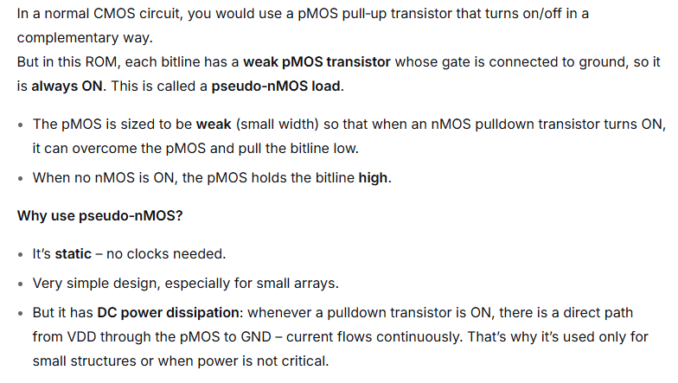
MODULE 5
Memory Array Subsystem
Pseudo‑nMOS – The Load

Slide 54
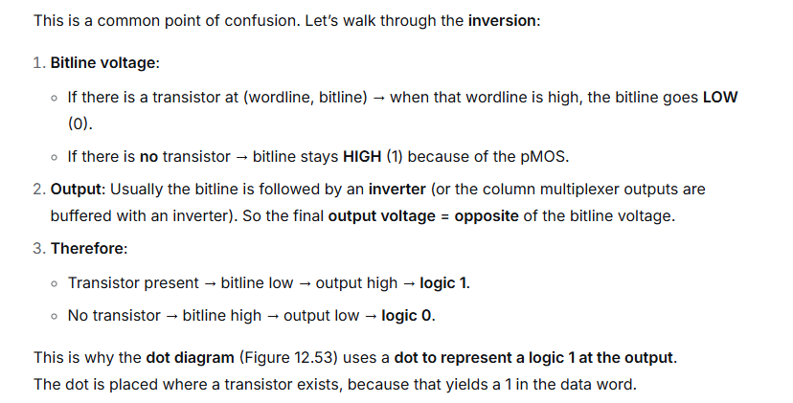
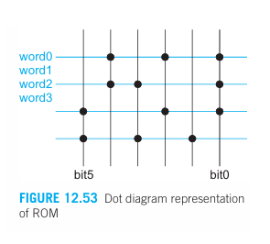

MODULE 5
Memory Array Subsystem
The Inversion – Dot Diagram

Slide 55
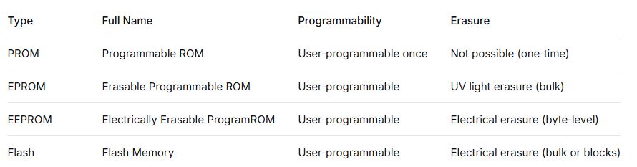
MODULE 5
Memory Array Subsystem
Programmable ROMs
PROMs use fuses.
EPROM, EEPROM, Flash use charge stored on a floating gate.

Slide 56
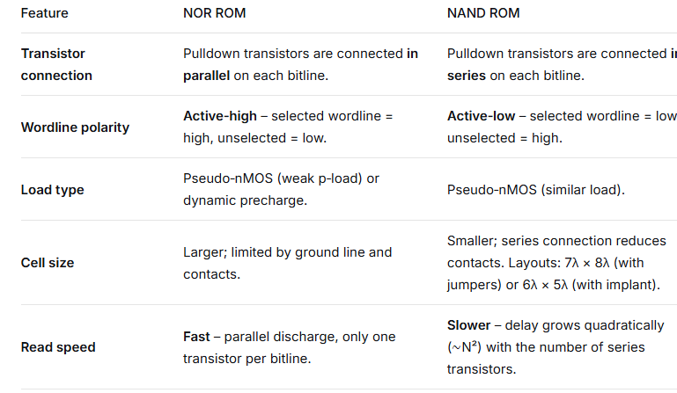
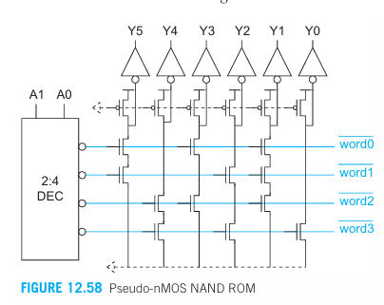
MODULE 5
Memory Array Subsystem

Slide 57
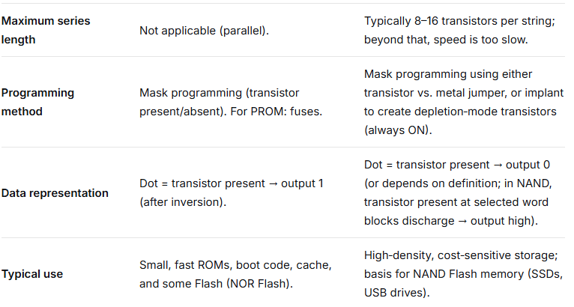
MODULE 5
Memory Array Subsystem

Slide 58
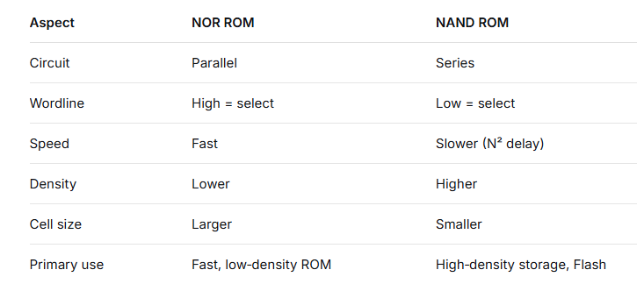
MODULE 5
Memory Array Subsystem

Slide 59
MODULE 5
Memory Array Subsystem
Flash Memory
Flash is a type of memory that keeps data even when power is off (non‑volatile) and can be reprogrammed electrically without removing the chip. It is the memory used in USB drives, SSDs, and memory cards.

Slide 60
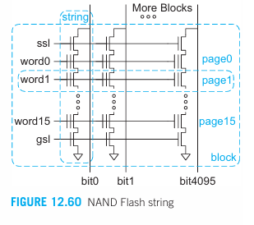
MODULE 5
Memory Array Subsystem
1. Bitlines (Vertical Conductors)
Bitlines run vertically through the array.
Each bitline (bit0, bit1, …, bit4095) is a metal line that connects to one string per block.
During read and program, the bitline carries the data (or voltage) for one bit of the page.
The number of bitlines determines the page width (here, 4096 bitlines = 4096 bits per page).
2. Strings (Series Chain of Cells)
A string is a series connection of floating‑gate transistors (memory cells) plus two select transistors.
In the diagram, each string has 16 memory cells (controlled by word0 to word15), a string select transistor (ssl) at the top, and a ground select transistor (gsl) at the bottom.
All transistors in a string share the same diffusion region (active area) and are connected in series between the bitline and ground.
The series arrangement eliminates the need for a contact to ground per cell, drastically reducing cell size.

Slide 61
MODULE 5
Memory Array Subsystem
3. Wordlines (Horizontal Conductors)
Wordlines run horizontally and connect the control gates of all memory cells that belong to the same page across all strings in the block.
Each wordline corresponds to one page. In the diagram, word0 to word15 → 16 pages per block.
Wordlines are used to select a page during read/program and to bias the control gates during erase.
5. Blocks
A block is the set of all pages that share the same set of strings.
It is the smallest unit that can be erased.
The block contains multiple strings (one per bitline) and multiple wordlines (pages). In this diagram, block j contains 4096 strings (each of 16 cells) → total 4096 × 16 = 65,536 cells per block.
Erase is performed on all cells of a block simultaneously by applying a high voltage to the substrate (p‑well) while grounding all wordlines in the block.
4. Pages
A page is the set of all memory cells that share the same wordline within a block.
It is the smallest unit that can be read or programmed (written) in NAND Flash.
The page size equals the number of bitlines (here 4096 bits = 512 bytes).

Slide 62

MODULE 1 MOS TRANSISTOR AND PROCESSING TECHNOLOGY

